Slide 1
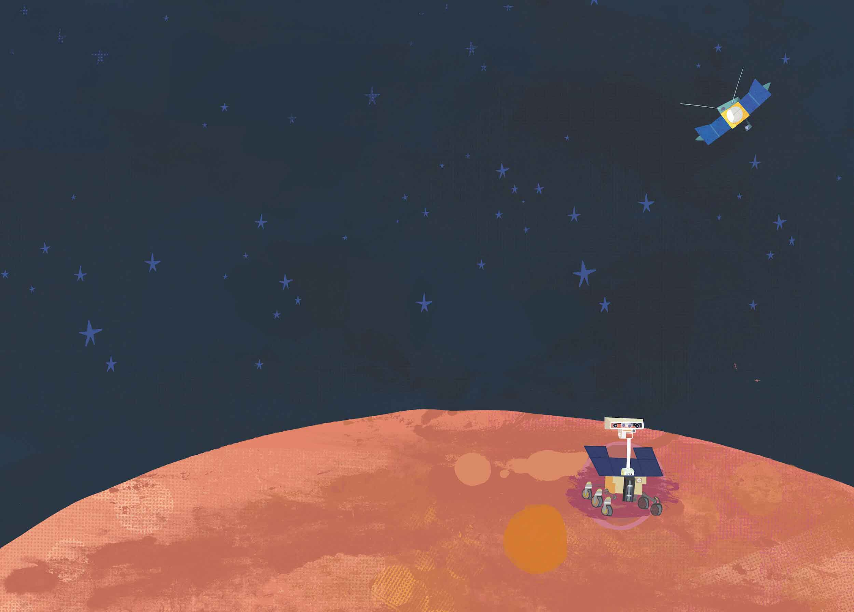
Activity 1.1
Signs of Life

Slide 2
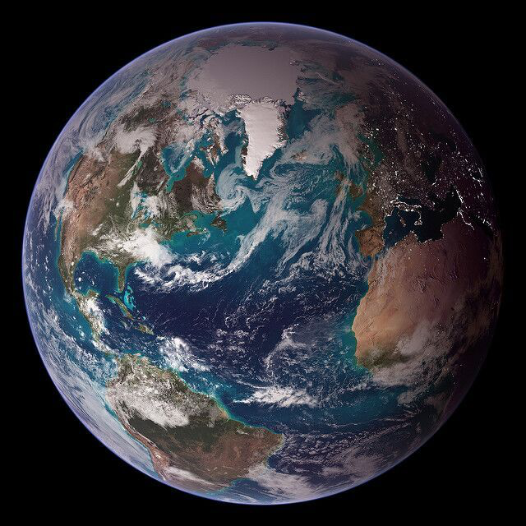
Earth
Look closely to see signs of life on Earth…
Notes:
Blue Marble - NASA Blue Marble 2007 West RELEASE DATE: OCTOBER 9, 2007.
Credit: NASA/Goddard Space Flight Center/Reto Stöckli.

Slide 3
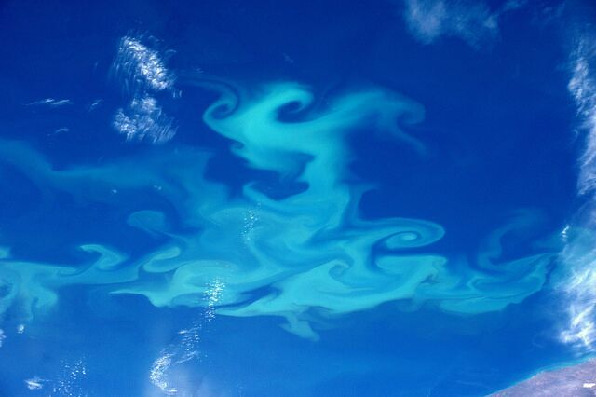
Oceans, seas and a plankton bloom!
Credits: ESA/NASA. Taken 1 April 2016.

Slide 4
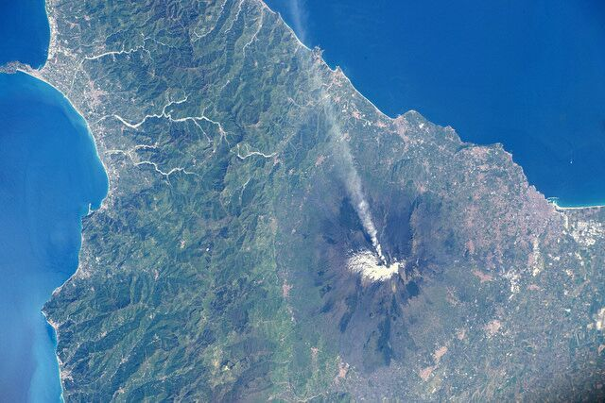
Volcanoes, like Mount Etna in Italy
Credits: ESA/NASA.
Pic taken by ESA Astronaut Tim Peake.

Slide 5
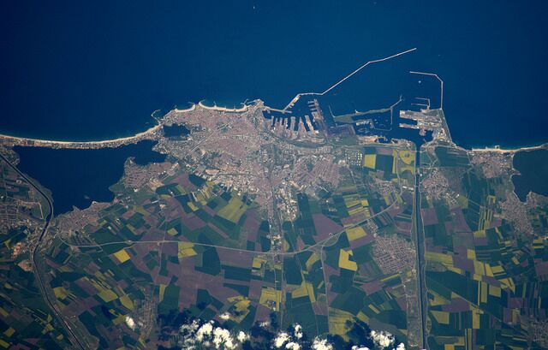
Constanta, the oldest continuously inhabited city in Romania.Credits: ESA/NASA. Taken by ESA Astronaut Tim Peake, 28 April 2016.

Slide 6
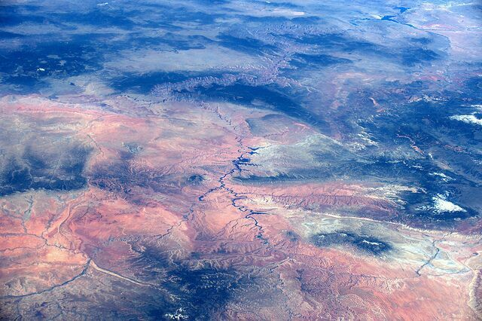
Follow Lake Powell to Lake Mead through the Grand Canyon! Credits: ESA/NASA. Taken 12 May 2017.

Slide 7
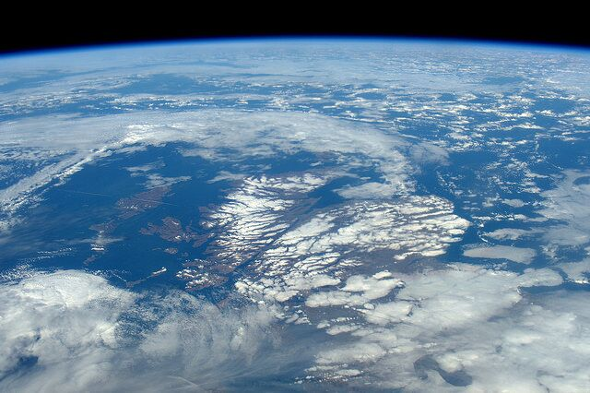
Snow capped mountains like Scottish Munro.
Credit: ESA/NASA. 27 February 2016.

Slide 8
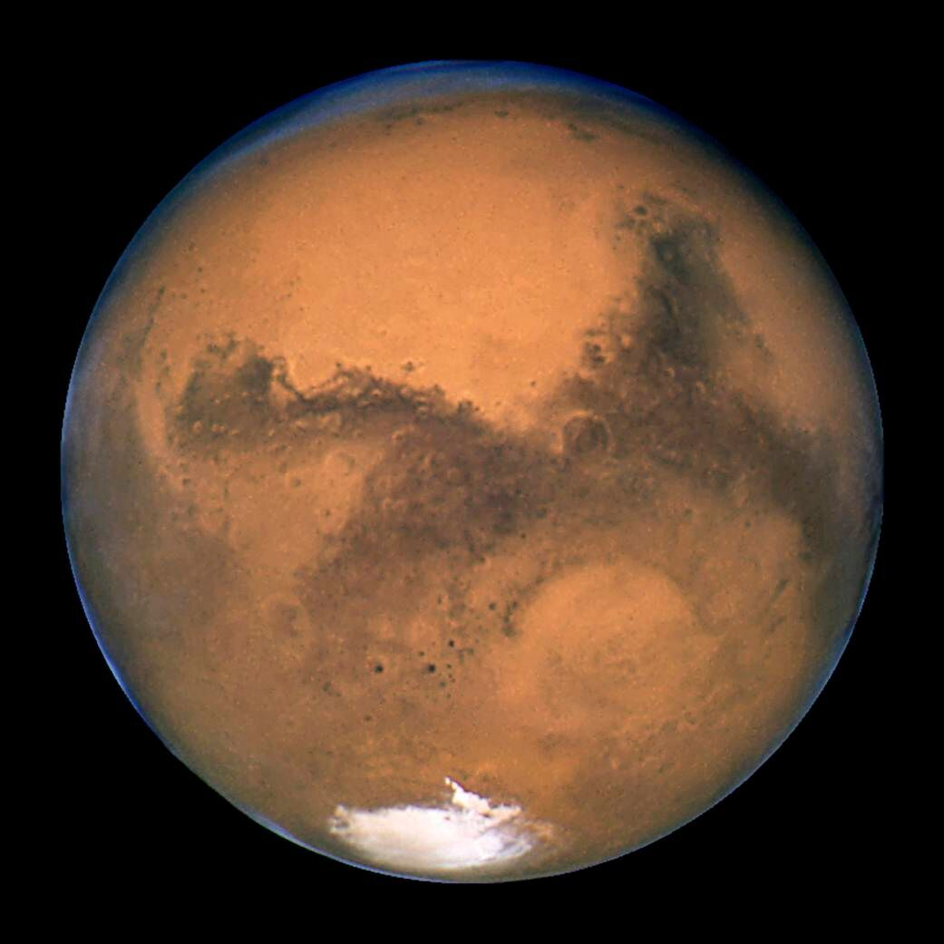
Mars
Life on Mars is harder to see…
Notes:
NASA's Hubble Space Telescope took this close-up of the red planet Mars when it was just 34,648,840 miles (55,760,220 km) away. Image credit: NASA, ESA, and The Hubble Heritage Team (STScI/AURA)

Slide 9
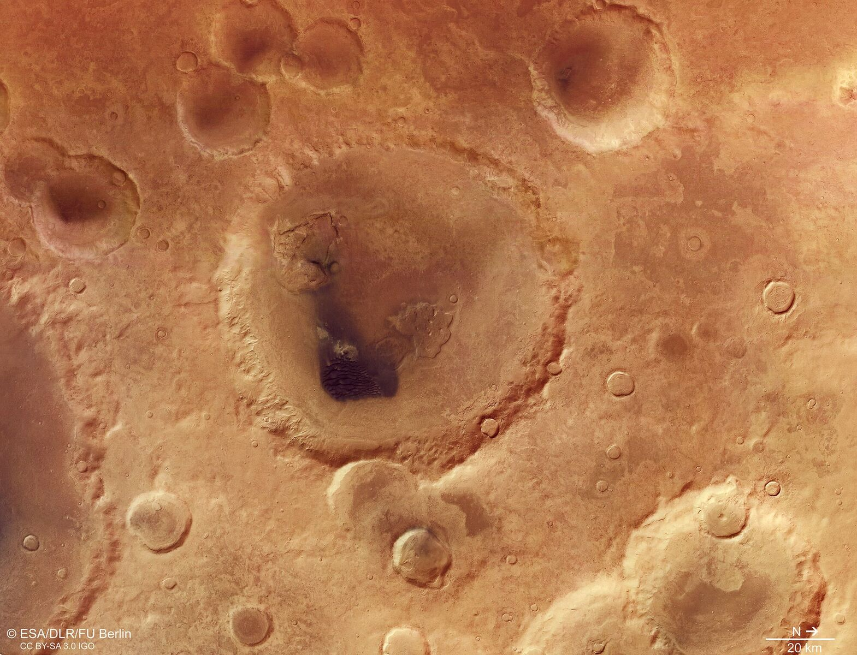
What could have caused these craters?
Copyright ESA/DLR/FU Berlin, CC BY-SA 3.0 IGO

Slide 10
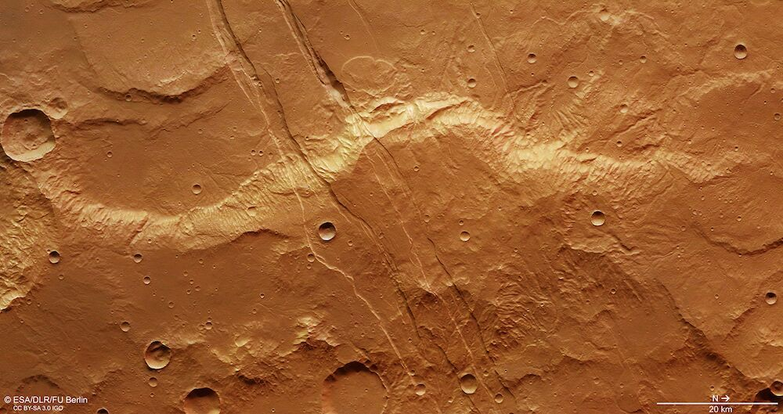
Could these fractures on the surface be the result of volcanic activity or running water? Copyright ESA/DLR/FU Berlin, CC BY-SA 3.0 IGO

Slide 11
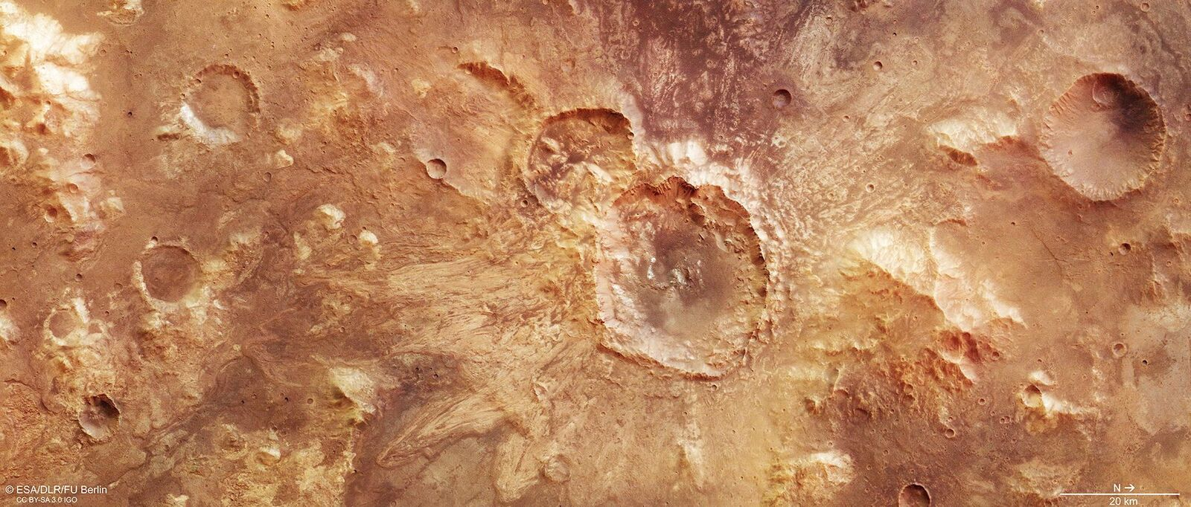
The debris around the edge of this crater tells scientists it was formed when Mars was a wetter planet.
Copyright ESA/DLR/FU Berlin, CC BY-SA 3.0 IGO

Slide 12
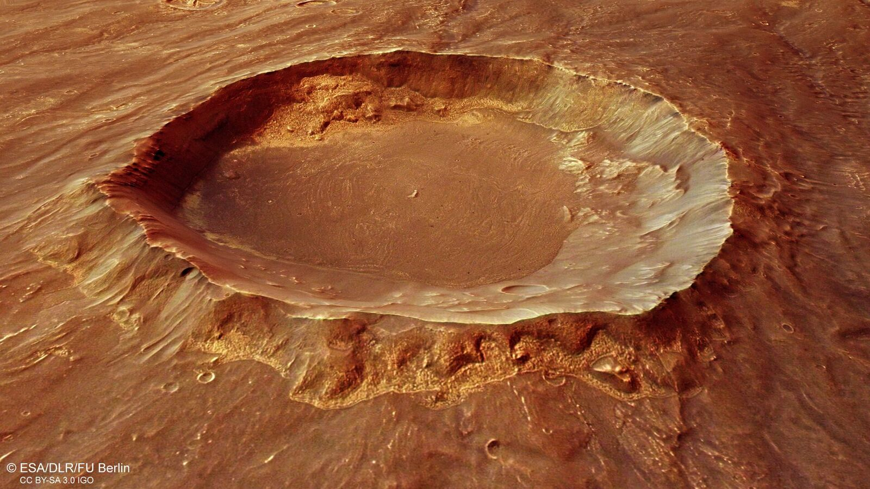
Looking into a 20 km-wide crater on Mars.
Scientists want to know what is below the surface
of Mars – could there be life below? Copyright ESA/DLR/FU Berlin, CC BY-SA 3.0 IGO

