Slide 1
Activity 3.2
Breaking News

Slide 2
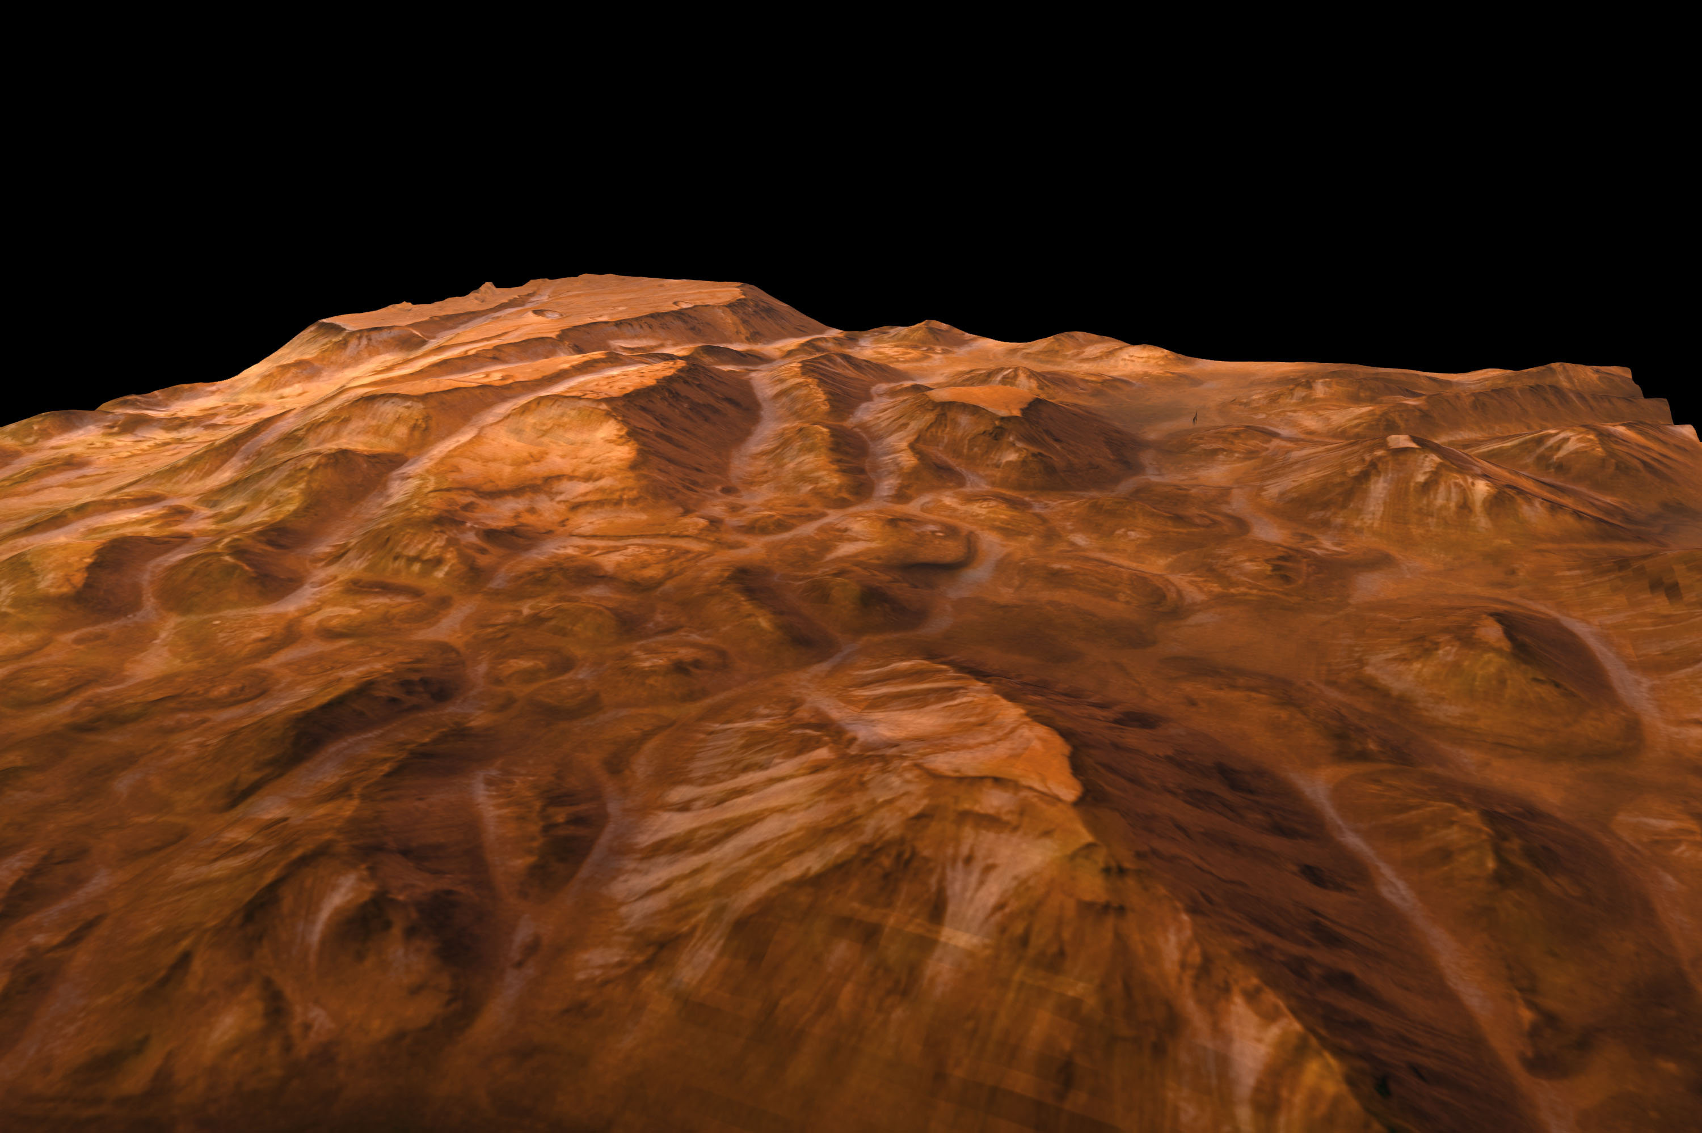
Valles Marineris, Mars. Credit: ESA/DLR/FU Berlin (G. Neukum)

Slide 3
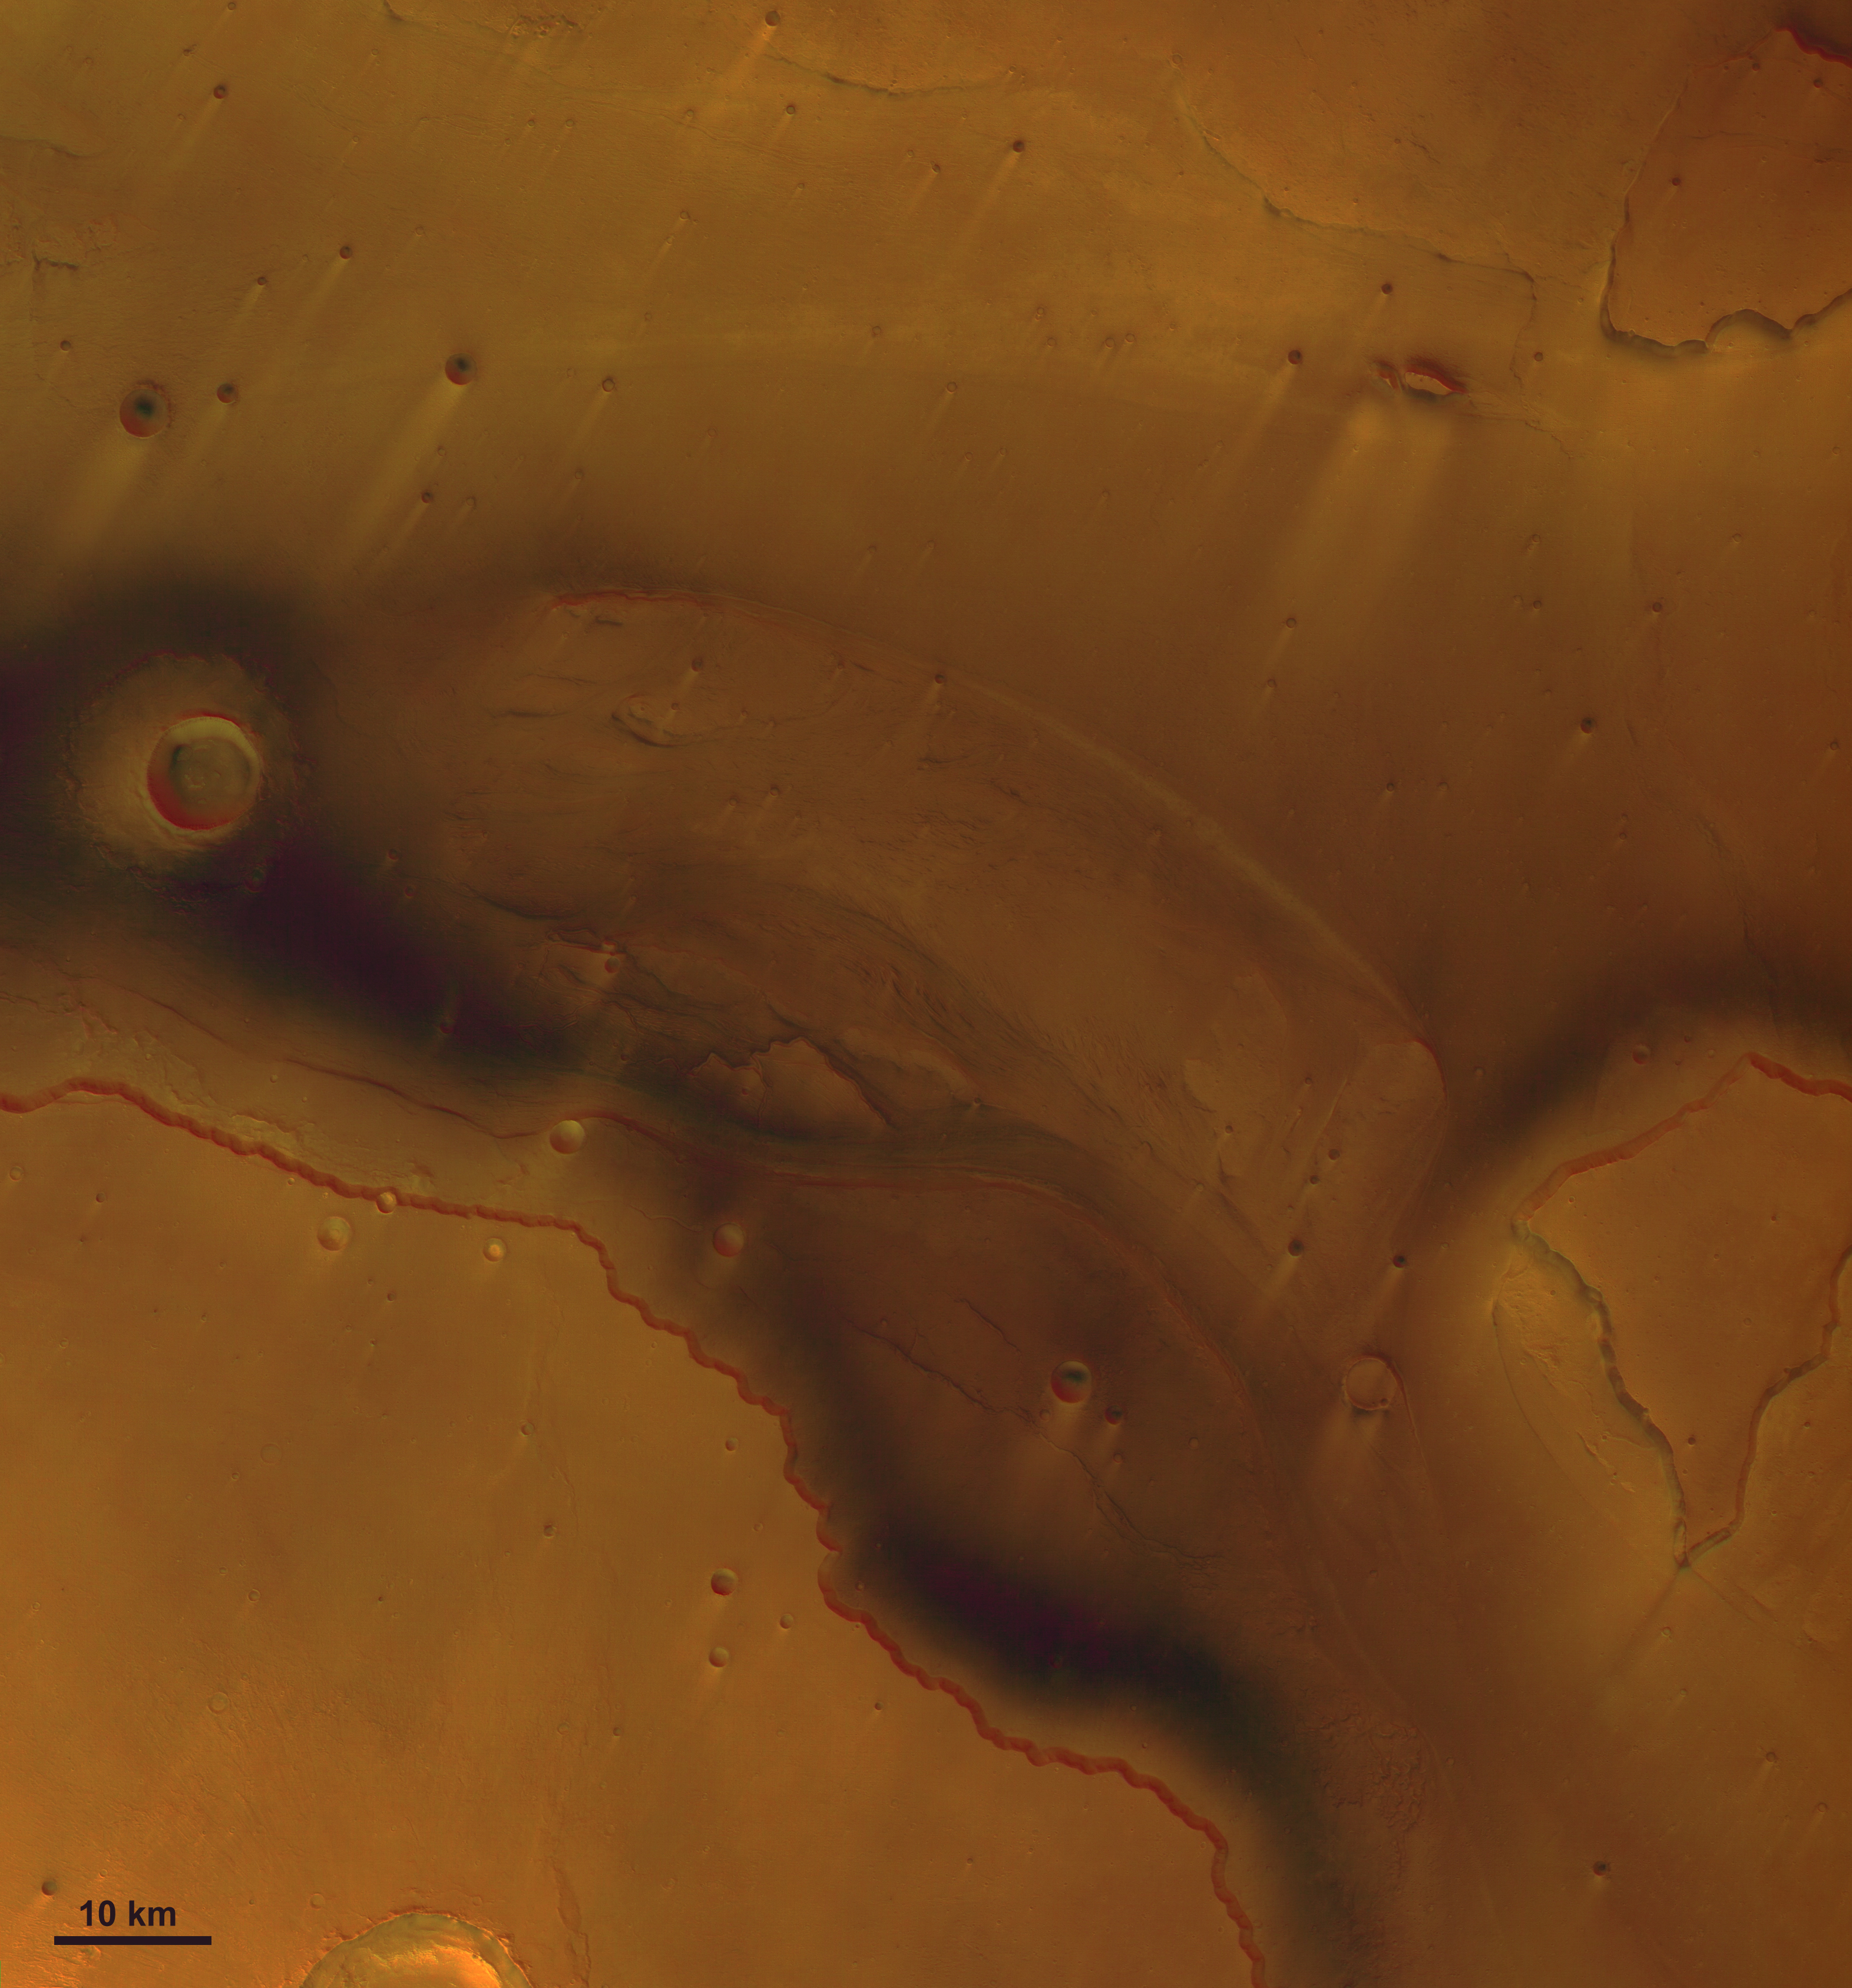
The mouth of Kasei Vallis, Mars. Credit: ESA/DLR/FU Berlin (G. Neukum)

Slide 4
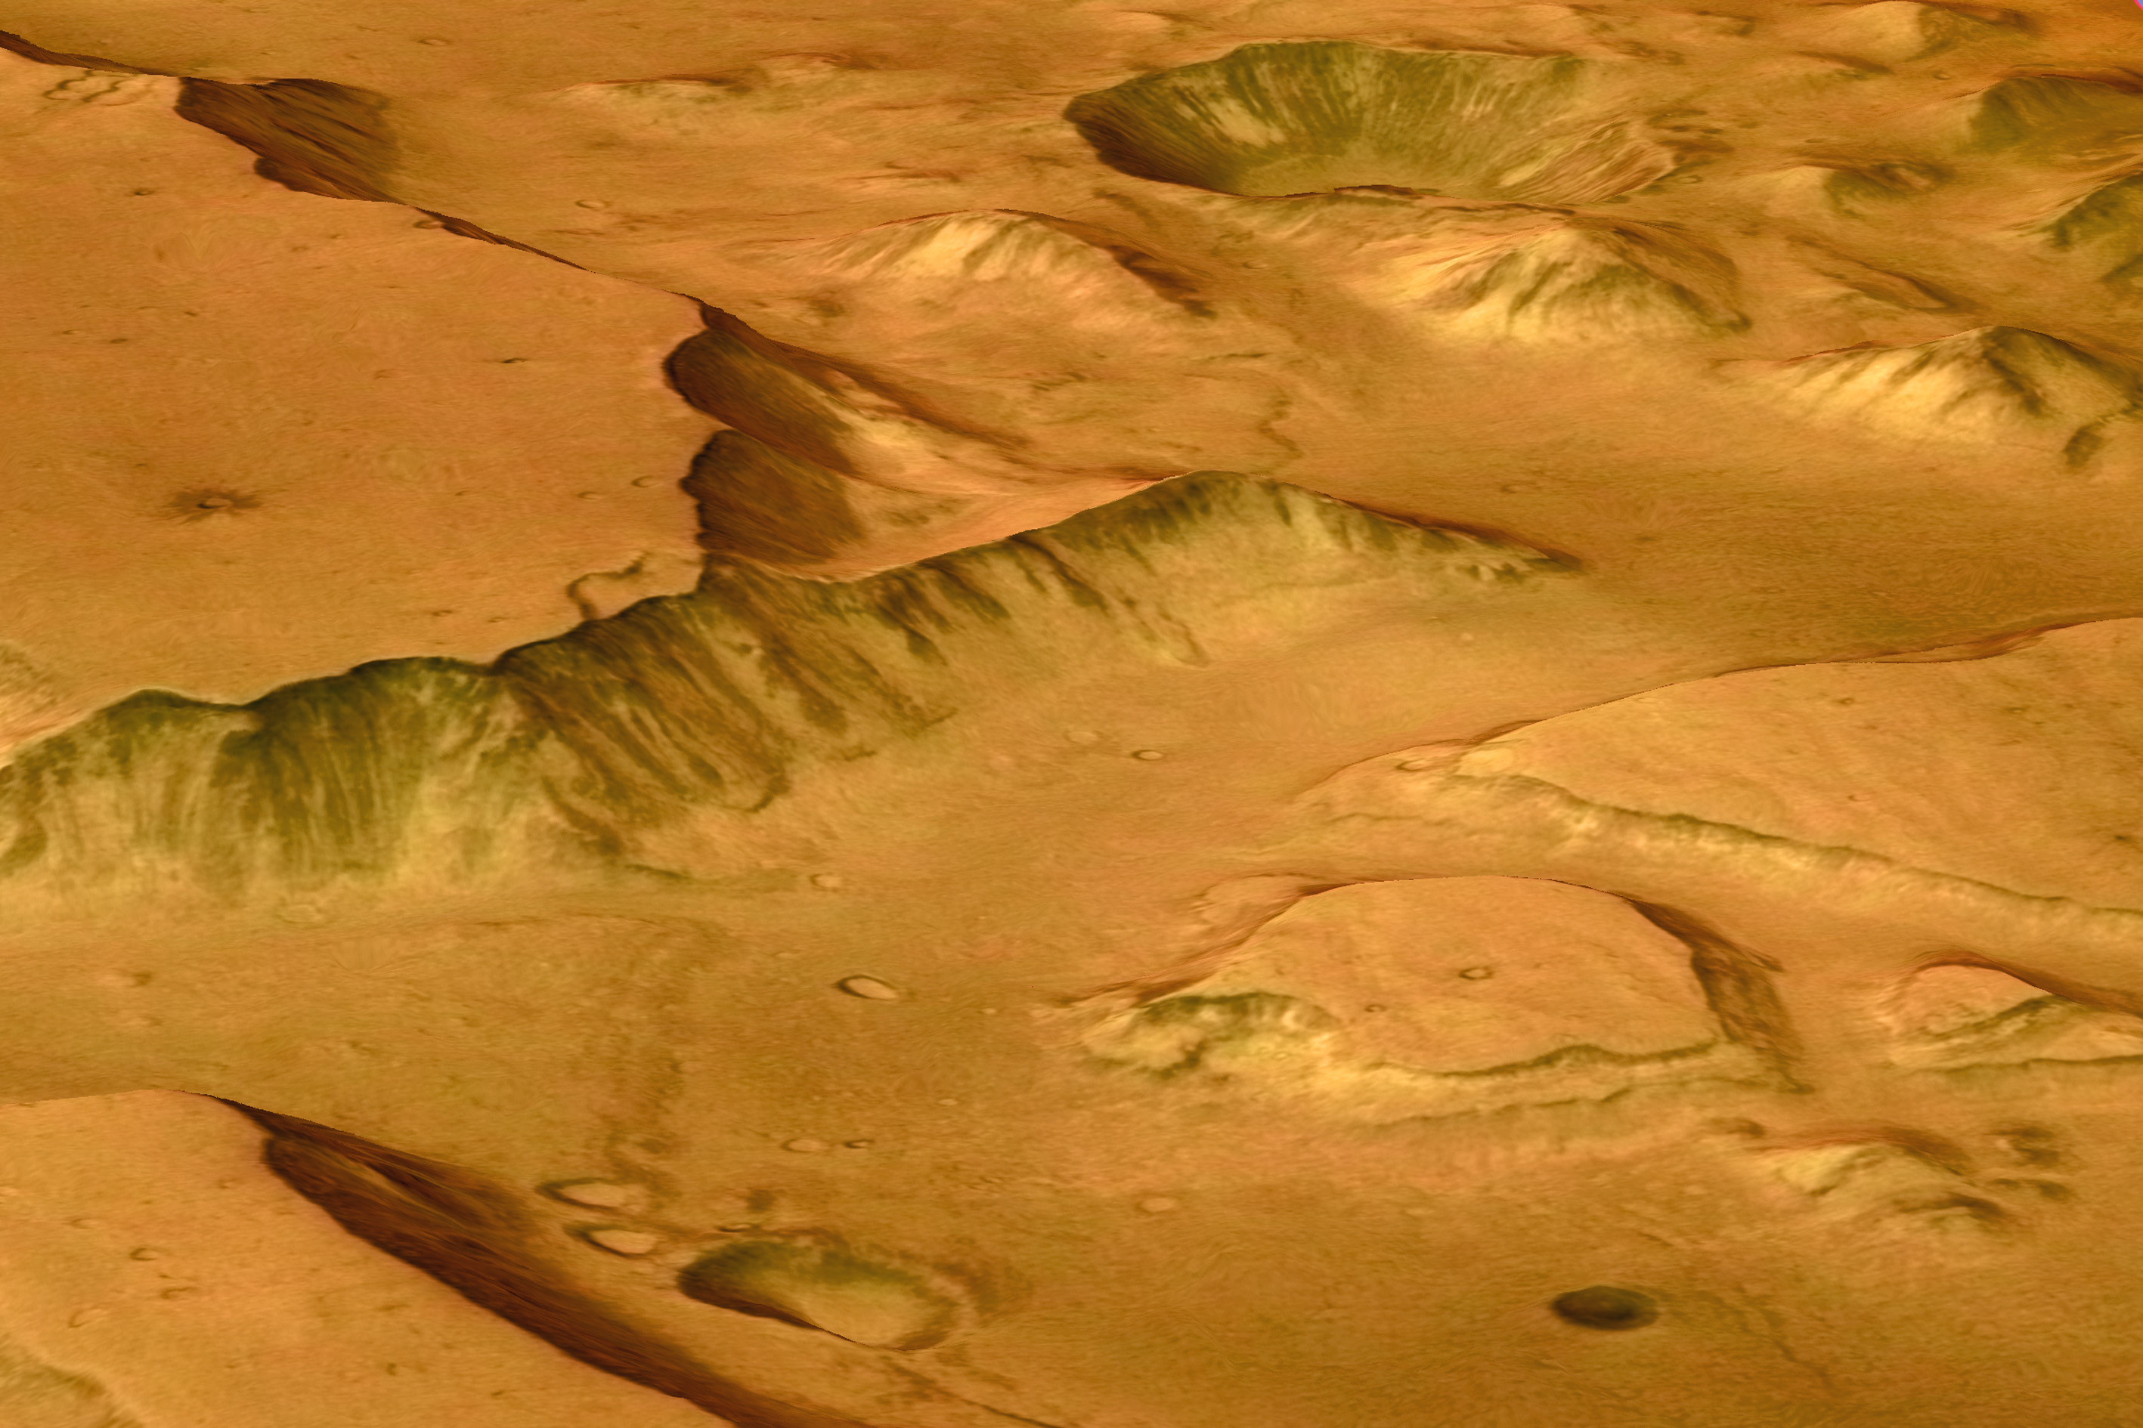
East of of Valles Marineris, Mars. Credit: ESA/DLR/FU Berlin (G. Neukum)

Slide 5
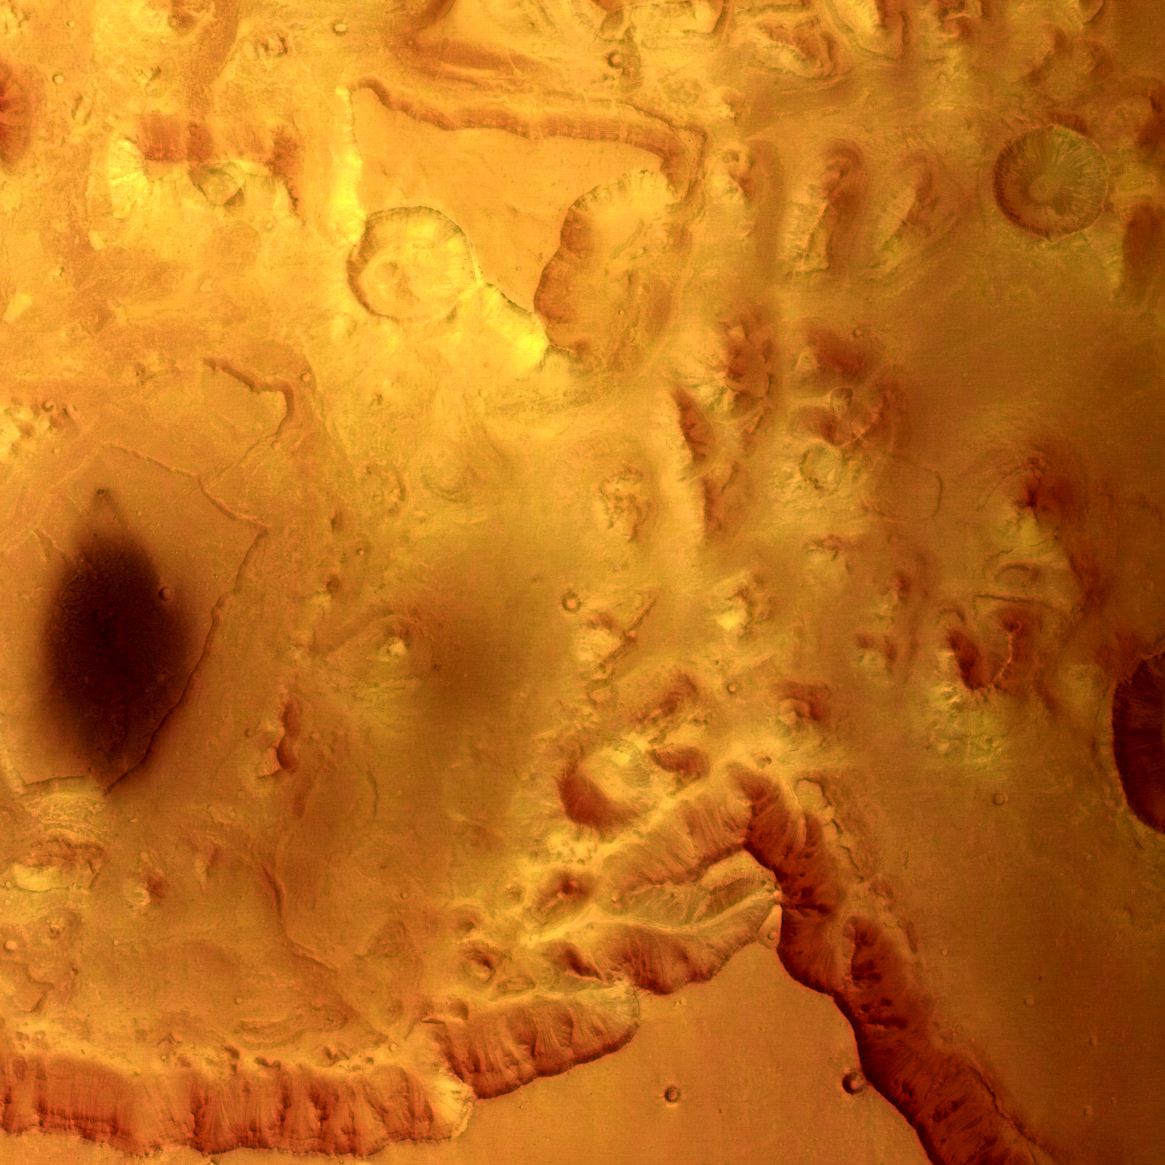
Valles Marineris, Mars. Credit: ESA/DLR/FU Berlin (G. Neukum)

Slide 6
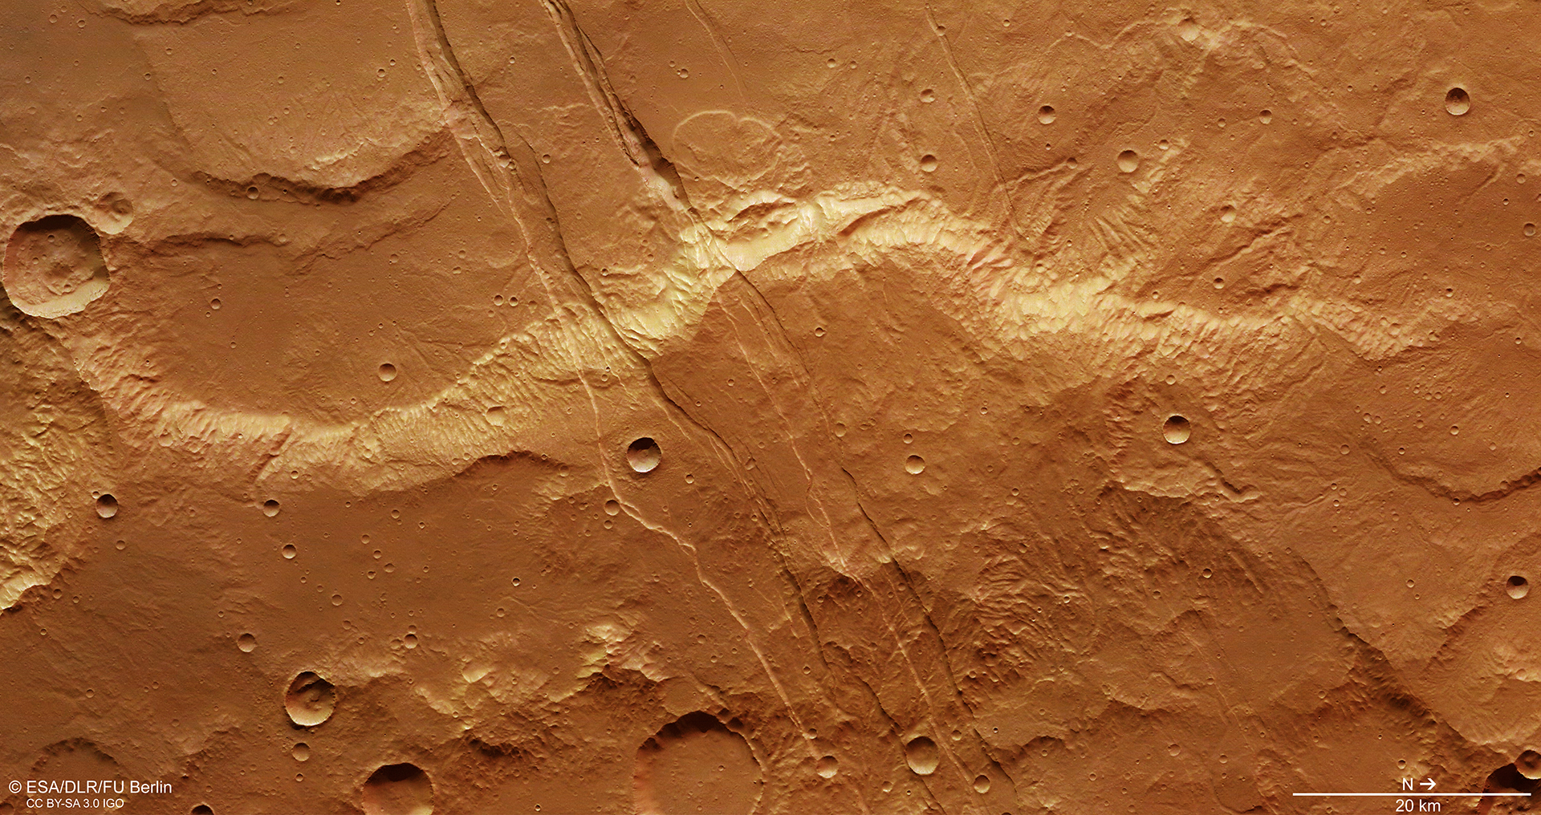
Sirenum Fossae fractures in the Tharsis volcanic region, Mars. Credit: ESA/DLR/FU Berlin

